Slide 1
December 2021

Slide 2
Overview
Decrease in revenues to £4.7m (H1 FY22: £5.9m)
Reduced Gaming revenues, due customer overstocking in FY22 and several of our customers being affected by a voluntary Chapter 11 bankruptcy petition by Aruze Gaming America Inc (“AGA”)
Vending revenues affected by a customer overstocking in FY22
Gross margin of 23.5%, 4.5% impact of £0.2m AGA-related stock impairment (H1 FY22: 31.7%)
EBITDA loss of £0.6m (H1 FY22: EBITDA £0.8m)
LBT of £0.9m (H1 FY22: PBT £0.4m), £0.3m of losses associated with impairment of doubtful receivables, due to AGA
Basic LPS of 7.5p (H1 FY22: EPS 3.0p)
No interim dividend proposed (H1 FY22: Nil)
Closing net cash of £5.4m (30 September 2022: £6.4m)
Note: - All monetary values, except EPS, individually reported across the presentation are rounded to the nearest £0.1m
1

Slide 3
Statement of comprehensive income
Group revenue £4.7m (H1 FY22: £5.9m)
Gross profit margin of 23.5% (H1 FY22: 31.7%)
4.5% impact of £0.2m AGA-related stock impairment
Change in sales mix, adversely impacted margin – lower volume of larger format sensors sold over period
April 2022 pay awards impact H1 FY23 vs H1 FY22 (April 2023 pay awards will impact H2 FY23)
Admin expenses of £2.0m (H1 FY22: £1.3m)
£0.3m doubtful receivables impaired associated with AGA
Higher travel and subsistence and marketing costs around increased prospecting activity
April 2022 pay awards impact H1 FY23 vs H1 FY22 (April 2023 pay awards will impact H2 FY23)
EBITDA loss of £0.6m (H1 FY22: EBITDA £0.8m)
LBT of £0.9m (H1 FY22: PBT of £0.4m)
Tax credit of £0.1m (H1 FY22: charge of £0.1m)
LPS of 7.5p (H1 FY22: EPS of 3.0p)
2

Slide 4
Statement of financial position & cashflow
Group statement of financial position remains solid, reported cash of £5.4m (30 September 2022: £6.4m)
Currency hedging strategy remains beneficial with more natural hedging in EUR
Cash position and cashflows
Cash utilised in operations of £0.4m (H1 FY22: generated £0.1m)
Working capital £0.2m decrease (H1 FY22: £0.7m increase)
Debtors and creditors decreased; stocks increased
Tax received £0.1m (H1 FY22: tax paid £0.1m)
Interest earned of £0.1m (H1 FY22: Nil)
Capex spend of £0.6m (H1 FY22: £0.2m)
R&D £0.3m (H1 FY22: < £0.1m), Plant & Equipment £0.3m (H1 FY22: £0.2m)
Dividend payments during period £0.2m (H1 FY22: £0.2m)
No interim dividend proposed (H1 FY22: Nil)
3

Slide 5
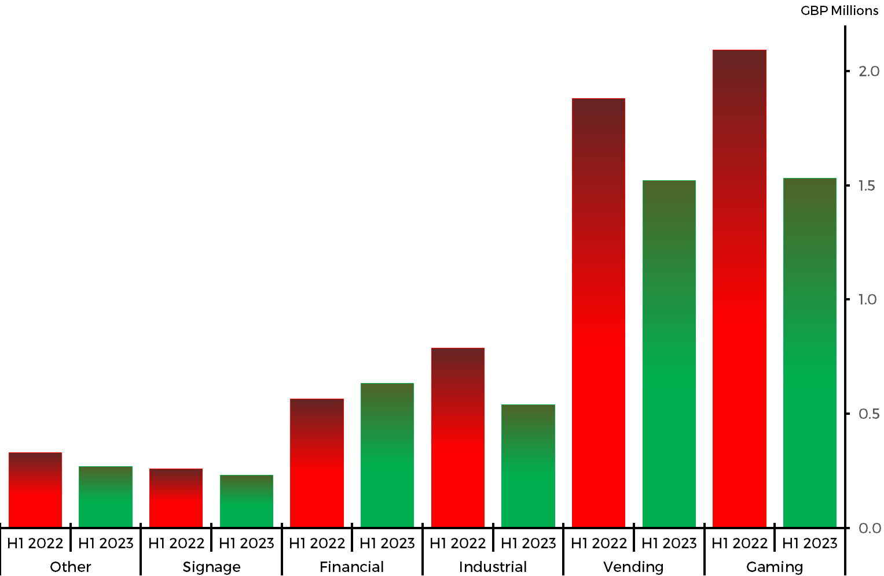
Overview - Sales
Total revenues of £4.7m (H1 FY22: £5.9m)
Impacted by unpredicted movements in both Gaming and Vending
Market | H1 2023 | H1 2022
Gaming | £1.5m | £2.1m
Vending | £1.5m | £1.9m
Industrial | £0.6m | £0.8m
Financial | £0.6m | £0.6m
Signage | £0.2m | £0.2m
Other | £0.3m | £0.3m
Total | £4.7m | £5.9m
Note: all £ values in the above table are rounded to nearest £0.1m
4

Slide 6
Sales - Markets
Market | Commentary
Gaming | Impacted by overstocking of items by a customer of goods manufactured in FY2022, further compounded by ongoing effects of AGA, voluntarily petitioning for Chapter 11 bankruptcy
Vending | Impacted by overstocking by supply chain for US OEM brand independent drink fountain manufacturer and in France, project loss of pizza vending machine OEM
Industrial | HMI devices and kiosks. Reduction in revenues in EMEA, related mainly to a pan European VAR, revenues from 2 sensor designs lower in H1 FY23 than H1 FY22
Financial | Primarily ATM products. Continuation of market maintenance levels of supply on older generation platforms. Revenues lower in Americas and APAC, compensated by increase in EMEA
Signage | Information systems and tables. Non major variations noted, either in geographies or with customers.
Other | Smaller markets, such as Telematics, Health, Military, etc. Lower EMEA sales main contributor, for a German based VAR supply a design for a medical device in COVID-19 period, not repeated in H1 FY23
5

Slide 7
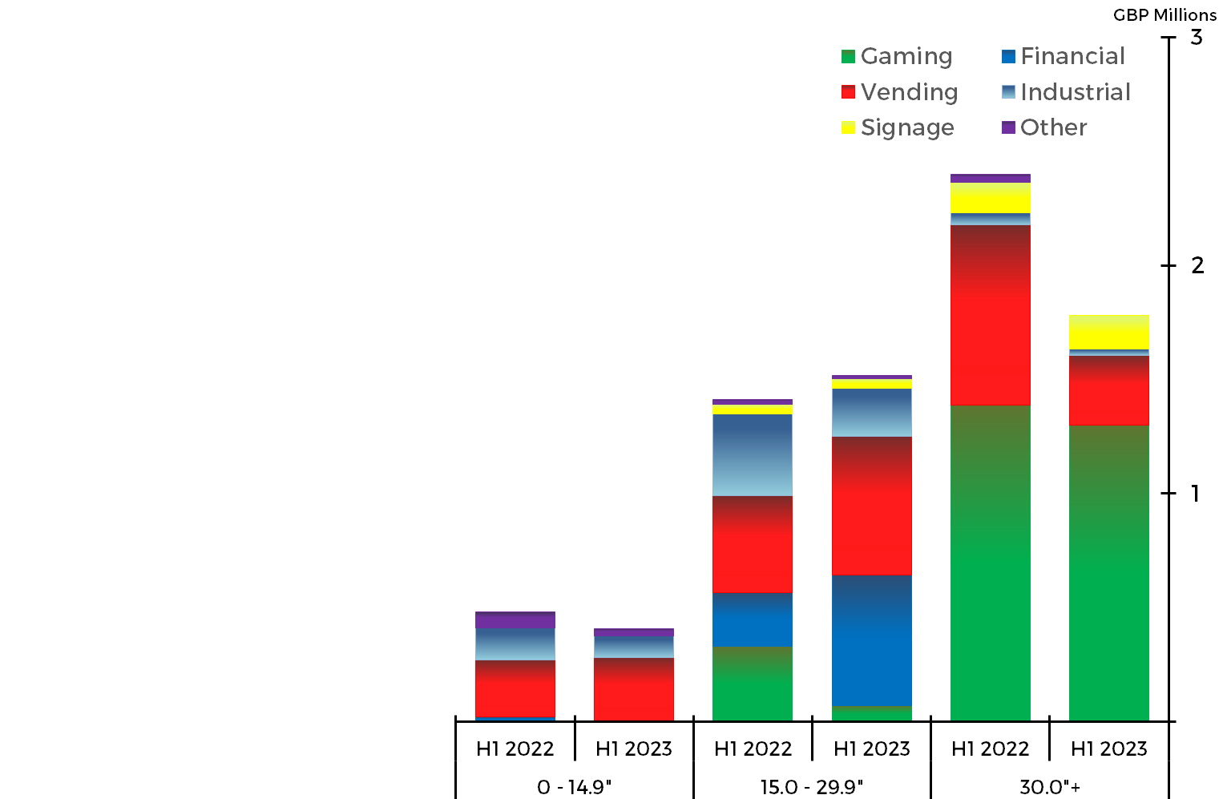
Touch sales - size range and markets
 | H1 2022 |  |  | H1 2023
Total Units | 29.3 |  |  | 22.7
Size Range | 0 - 14.9” | 15.0” - 29.9” | 30.0” + | 0 - 14.9” | 15.0” - 29.9” | 30.0” +
Units (k) | 8.9 | 13.4 | 7.0 | 6.6 | 11.8 | 4.3
Volume of MPCT™ units |  | 5.7k (2022: 9.1k)
Volume of Curved units |  | 2.7k (2022: 3.5k)
Note: Revenue as illustrated on graph are for touch sensor only sales and exclude sales of controllers and ancillaries
6

Slide 8
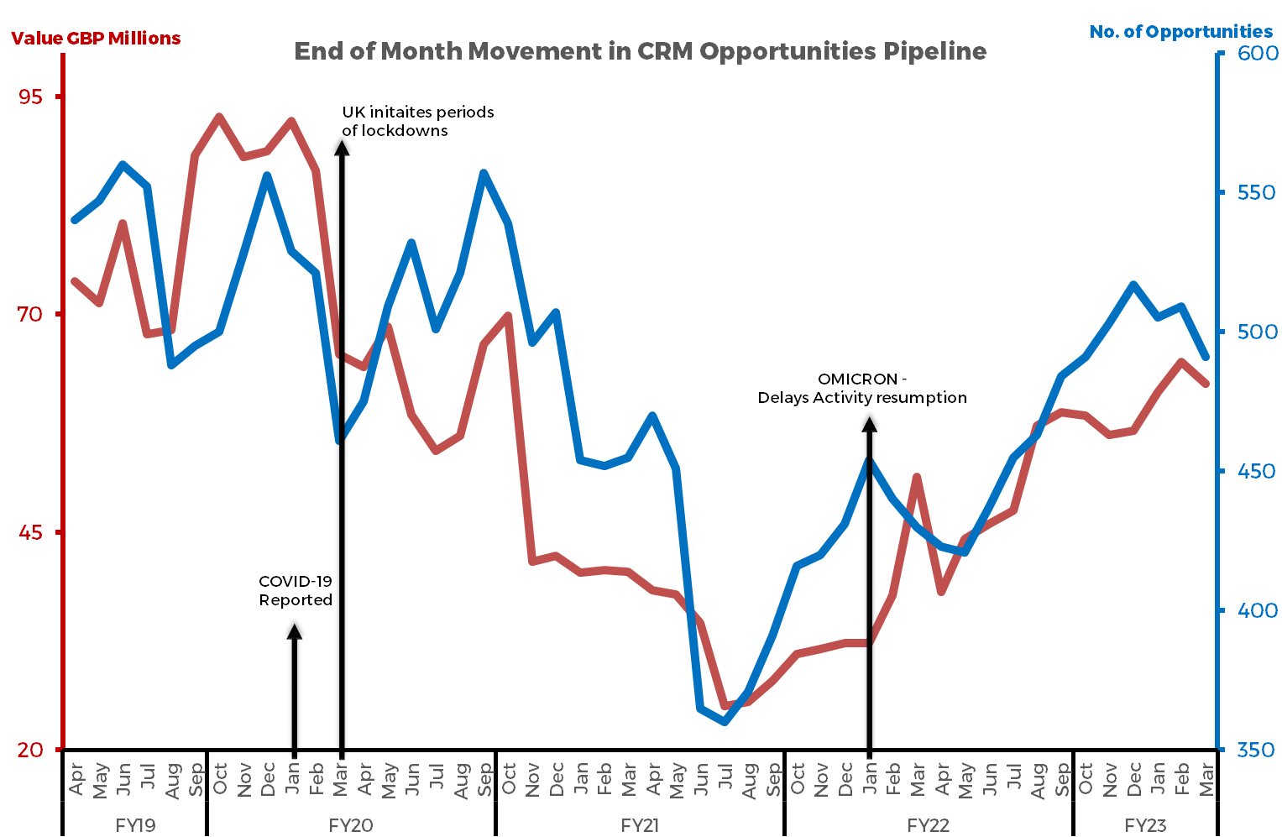
Opportunities
31 March 2023 – 491 Opportunities with Customer Projected Lifetime Value (“CPLV”) of £62m (30 Sept 2022: 484, £59m)
Market | No. Opps | Value
Vending | 156 | £33.5m
Gaming | 30 | £11.0m
Financial | 16 | £3.7m
Signage | 124 | £3.7m
Industrial | 85 | £3.2m
Other | 80 | £6.9m
7

Slide 9
Developments
2nd generation laser bonding system, operational from Jan 2023
Installation underway of new integrated ERP/CRM system for improved management controls
R&D manpower into electronic components problem solving reduced, increasing time in product/process developments
Third party collaboration on PCAP metal mesh sensors, using Zytronic controller electronics
Evaluation of regional contract lamination of Zytronic film sensors
Productionising of floating button tech in Zytronic touch sensors
Evaluation and design of final use products using Zytronic tech, e.g., bespoke interactive tables
Global expo returning to normality, participation at following events during period
Gaming - G2E (USA, Oct), ICE (UK, Feb)
Signage & Vending – ISE (Spain, Feb)
Industrial - Embedded World (Germany, March)
8

Slide 10
Summary and outlook
Revenue, gross margin and profit, affected by occurrences of unpredicted events in Vending and Gaming markets
Cash of £5.4m provides solid platform
Global business development and marketing activities returned to pre-COVID levels
R&D returning to increased process, technology and product development, as electronic component supply issues ease
Opportunities pipeline rebuild continues
New permanent Chair of Board appointment expected in coming months
Expected second half revenue generation hampered, with an expected end of year outcome in the range of £8.0 to £8.8m, as per trading update 4 May 2023
9

Slide 11
Appendices
10

Slide 12
Consolidated statement of comprehensive income
 | Unaudited six months to 31 March 2023 | Unaudited six months to 31 March 2022 | Audited 12 months to 30 Sept 2022
Group revenue | £4.7m | £5.9m | £12.3m
Gross profit | £1.1m* | £1.9m | £3.8m
Gross margin | 23.5%** | 31.7% | 30.5%
Group operating (loss)/profit | (£1.0m)*** | £0.4m | £0.7m
Operating margin | (20.6%) | 6.8% | 5.6%
Net income | £0.1m | - | -
(Loss)/profit before tax | (£0.9m) | £0.4m | £0.7m
Tax credit/(expense) | £0.1m | £0.1m | (£0.1m)
(Loss)/profit for the period | (£0.8m) | £0.3m | £0.6m
(Loss)/earnings per share - Basic | (7.5p) | 3.0p | 5.6p
* Inclusive of £0.2m for impairment of stock; ** inclusive of 4.5% due to stock impairment
*** inclusive of £0.3m debt impairment
11

Slide 13
Consolidated statement of financial position
 | Unaudited six months to 31 March 2023 | Unaudited six months to 31 March 2022 | Audited 12 months to 30 Sept 2022
Non-current assets | £6.0m | £5.9m | £5.8m
Current assets (less cash) | £4.1m | £4.2m | £5.2m
Cash | £5.4m | £7.5m | £6.4m
Total assets | £15.5m | £17.6m | £17.4m
Current liabilities | (£0.8m) | (£1.5m) | (£1.7m)
Non-current liabilities | (£0.5m) | (£0.3m) | (£0.5m)
Total liabilities | (£1.3m) | (£1.8m) | (£2.2m)
Net assets | £14.2m | £15.8m | £15.2m
12

Slide 14
Consolidated cashflow statement
 | Unaudited six months to 31 March 2023 | Unaudited six months to 31 March 2022 | Audited 12 months to 30 Sept 2022
(Loss)/profit before tax | (£0.9m) | £0.4m | £0.7m
Depreciation and amortisation | £0.3m | £0.4m | £0.8m
Movement in working capital | £0.2m | (£0.7m) | (£1.4m)
Tax received/(paid) | £0.1m | (£0.1m) | (£0.2m)
Net cash (used in)/ from operating activities | (£0.3m) | (£0.1m) | (£0.1m)
Net cashflow used in investing activities | (£0.5m) | (£0.2m) | (£0.5m)
Net cashflow used in financing activities | (£0.2m) | (£1.3m) | (£2.2m)
Decrease in cash | (£1.0m) | (£1.6m) | (£2.8m)
Net cash | £5.4m | £7.5m | £6.4m
13

Slide 15
5-yr financial comparisons
Year ended | 30-Sept-18 | 30-Sept-19 | 30-Sept-20 | 30-Sept-21 | 30-Sept-22
Revenue (£m) | 22.3 | 20.1 | 12.7 | 11.7 | 12.3
Gross margin (%) | 37.0 | 33.7 | 20.1 | 30.3 | 30.5
EBITDA (£m) | 5.2 | 4.1 | 0.7 | 1.4 | 1.5
PBT/(LBT) (£m) | 4.2 | 3.1 | (0.4) | 0.5 | 0.7
EPS/(LPS) (FD)/(AD) (p) | 22.7 | 16.6 | (1.8) | 3.0 | 5.6
Dividends for year (p) | 22.8 | 22.8 | nil | 1.5 | 2.2
Net cashflow from operating activities (£m) | 4.8 | 2.8 | 3.2 | 2.1 | -0.1
Net cash (£m) | 14.6 | 13.1 | 14.0 | 9.2 | 6.4
14

Slide 16
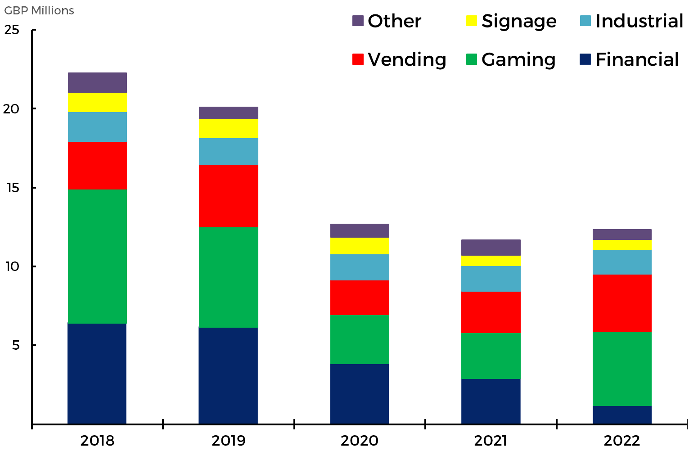
5-yrs - revenues by markets
15

Slide 17
The Board
Interim Chair – Mark Butcher
Mark has over 20 years’ experience in the City where he was an Executive Director of GPG (UK) Holdings plc which was the UK investment arm of Guinness Peat Group plc. In addition to investment management, he has wide experience in international accounting, corporate finance and banking transactions. He has sat as a Non-executive Director on the Boards of a number of public and private companies and is currently a Non-executive Director of Redde Northgate plc, AssetCo plc and National Milk Records plc. He is Chair of the audit committees of Redde Northgate plc and National Milk Records plc. Mark graduated with a Batchelor of Commerce degree from the University of Cape Town and qualified as a Chartered Accountant in South Africa.
Chief Executive Officer – Mark Cambridge
Mark has been Chief Executive since January 2008 after being appointed to the Board in June 2007, and acted temporarily as Chair between October 2022 and February 2023. Mark is the Managing Director of the operating subsidiary Zytronic Displays Limited a position he has held since 2006 where he has held the prior positions of Sales and Marketing Director and Technical and Quality Director and is also President of its subsidiary Zytronic Inc. Mark is a Materials Science graduate with prior industrial experience in the nuclear and metal casting industries and has a Securities Institute Certificate in Corporate Finance.
Group Finance Director – Claire Smith
Claire is a graduate in Business and Finance, CIMA accredited with a certificate in International Cash Management. She held various positions with Procter & Gamble and the NAAFI, before joining Zytronic Displays Limited in April 2007, as Group Financial Controller. In 2012, Claire was appointed Finance Director of the operating subsidiary Zytronic Displays Limited and Finance Director of Zytronic Plc in January 2014. Claire is also the Group Company Secretary
Non-Executive Director – John Walter
John has for the last 15 years been independently managing funds, investing in under researched UK small and mid-cap stocks, having previously founding and working at Metis Asset Management between 2006 and 2008. Prior to this John was an equity research analyst at Equity Investigator and a former Vice President of Chase Manhattan International where he built the bank’s high yield distribution base in Europe. John is also Chair of the Friends of Herne Hill Velodrome and governor at Harris Academy, Clapham. John holds a Master degree in Social Anthropology with International Relations from the University of St Andrews.
16

